Slide 1
ADSD Final Project
Muhammad Ahmad Waseem – Arbab Haider – Muhammad Bilal

Slide 2
Contents
Overview of the project and Initial Ideas
Designing the first layer
Results after first layer
Extending design to second layer
Results after second layer
Adding dense layer: Final Design
Problems

Slide 3
Overview of the project and Initial Ideas

Slide 4
Overview of the project and Initial Ideas
The overall goal of the project was as follows:
Design a hardware for LeNet Model designed for handwritten digit recognition
The deign consists of 3 parts:
A schedule engine responsible of picking values from RAM and saving them on-tile as well as saving outputs from on-chip at desired location to RAM.
A controller that passes tiles from on-chip memory to the compute engine and saves corresponding outputs on-chip
A Compute engine capable of performing desired operations on the provided tiles
Simulate the design using a sample image (Sample Image and weights were provided as fixed-point numbers)

Slide 5
Overview of the project and Initial Ideas
Initial Ideas for layer 1:
Load 6*28 values from memory
Load first 5*5 weights from memory
Use for loops and compute convolution in a single cycle

Slide 6
Overview of the project and Initial Ideas
Issues with this approach:
Takes a lot of space on hardware. Approximately 1200 multipliers and 1188 adders
As we move forward, using for loops becomes extremely complicated
Pooling layer is very difficult to append when using for loops

Slide 7
Designing the first layer

Slide 8
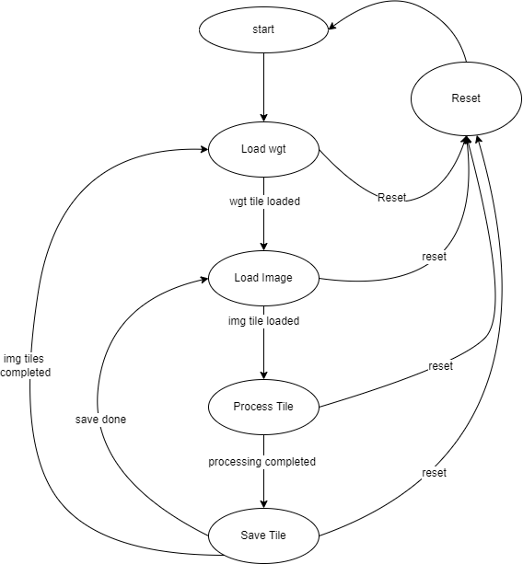
Designing the First Layer : FSM
The job done in each state is as follows:
Start: Loads all initial values like starting address for image to zero, etc.
Load_wgt: The address generator loads weights in wgt_tile
Load_img: Once a single weight is loaded, image tile is loaded. A portion of 6*28 is loaded starting from initial address. This initial address is set at start and is incremented iteratively once processing is completed
Process_tile: This stage utilizes on chip wgt_tile and Image_tile (6*28) along with compute engine to generate outputs and saves them on chip
Save_tile: A complete output created on-chip is written to RAM using the schedule engine

Slide 9
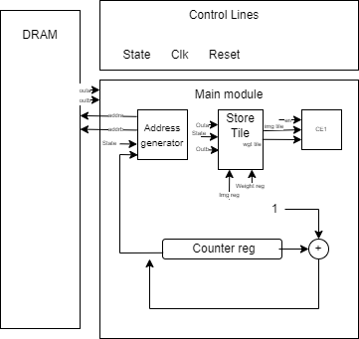
Designing the First Layer: Micro-Architecture
Address Generator:
This module is used to communicate with DRAM while reading/writing any value. Based on the value of state, it uses different offsets and thresholds to create next address. There are counters that keep check of value (which value is to be stored), tile number (which tile of input image correspond to this), and weight number (which weight layer correspond to this).
Store Tile:
The outputs from DRAM is to be stored on-chip carefully. This module takes care of saving read value from DRAM at desired place of on-chip memory. This module also saves output generated from compute engine into on chip output tile before it is saved back to DRAM.

Slide 10
Designing the First Layer: Micro-Architecture
Compute Engine (CE):
This module takes 6*6 portion of Image_tile (present on chip), 5*5 weight matrix and applies convolutional as well as pooling formulas to compute corresponding single output, which is saved on-chip. The compute engine consists of:
100 multipliers for 4 dot products of (5*5) blocks of images with (5*5) weights
96 adders for completing those 4 dot products
4 2-to-1 MUX to apply non-linearity (ReLu)
3 additional adders to complete average pooling (division here is done by shifting)

Slide 11
Designing the First Layer: Problems faced & Solution
The first problem was faced in implanting FSM as we could not handle states properly, but we used examples provided in lectures to successfully do that.
The second problem was designing a signed multiplier which was very challenging. So, we used ip module of signed multiplier.
The third and major problem was overflows. When adding signed numbers (25) there were some places where we had signed overflow and we had to study a lot to tackle that. What we did is that we added one bit extension to each of these 25 inputs and then added them, causing use of one extra bit.

Slide 12
Results after first layer

Slide 13
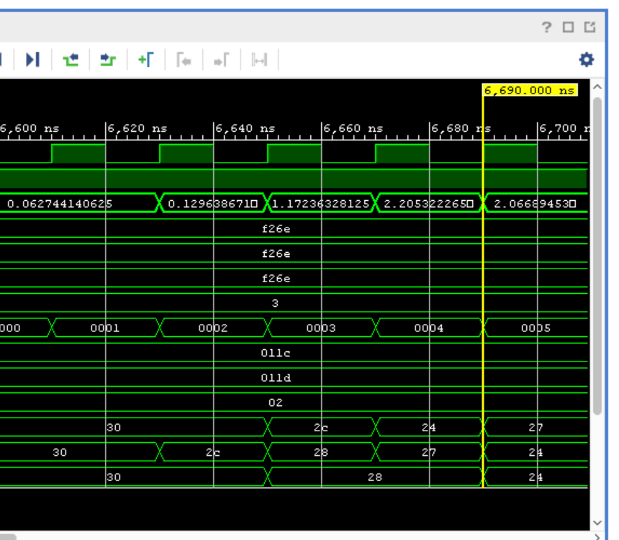
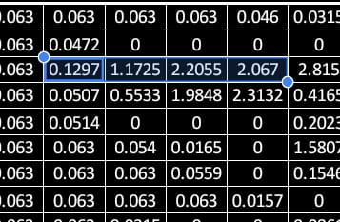
Results after first layer
Desired Output of first layer
Corresponding output on vivado

Slide 14
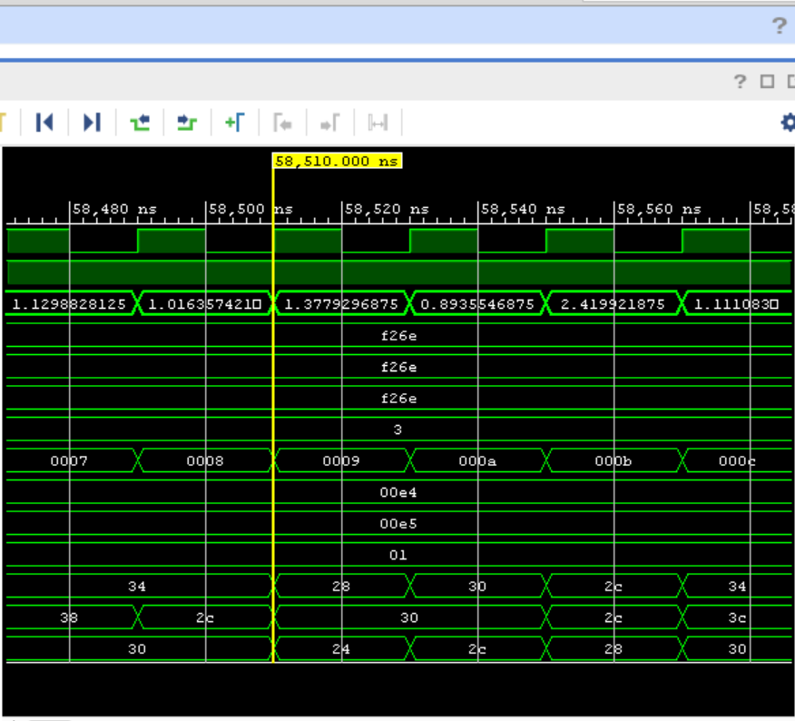
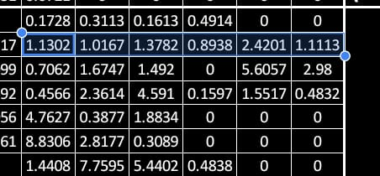
Results after first layer
Desired Output of first layer
Corresponding output on vivado

Slide 15
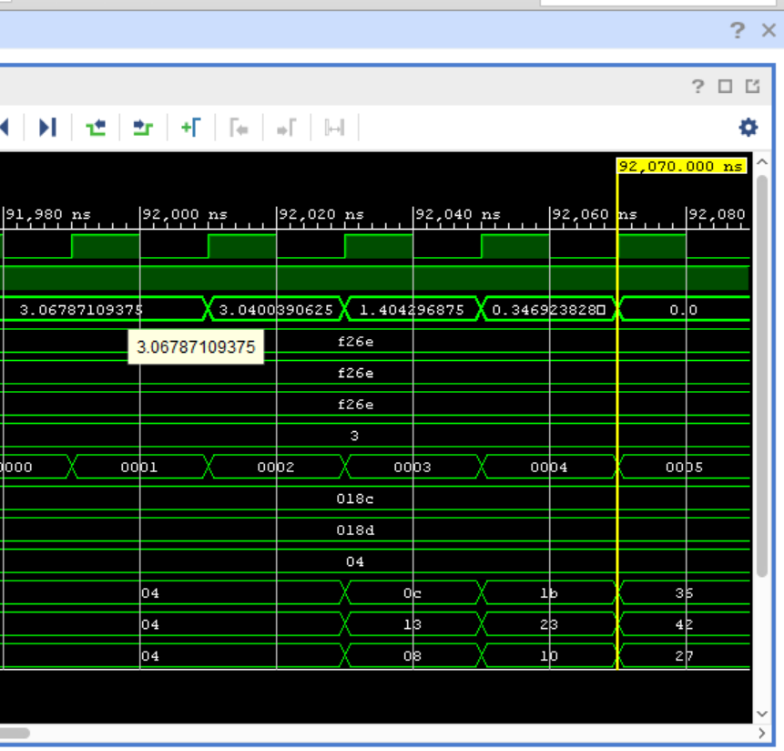
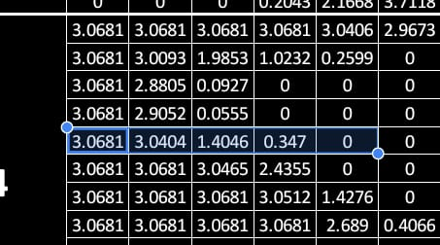
Results after first layer
Desired Output of first layer
Corresponding output on vivado

Slide 16
Extending the design to second layer

Slide 17
Extending the design to second layer
To extend the design to second layer we did the following:
Instead of using define values for threshold, we introduced registers that store information regarding the layer for example how much is input size, how much is wgt size, how much is depth, what are the addresses offsets for that layer etc. In this way, we check the layer number in our Init state and update those registers there\.
During loading, all depths are loaded for the previous layer for example 6*12*6 tile is loaded for second layer and hence an information regarding at which depth we are working and how many we have to go is added into wgt loading and img loading stages
Address generator now handles depth information using a separate depth counter register to make sure we pick right value from right depth
A common wgt_tile and img_tile reg on chip used. It has the storage to incorporate maximum space used on-chip which is 168*6 for first two layers for img and hence we do not need to take care of these issues of picking a register to save.

Slide 18
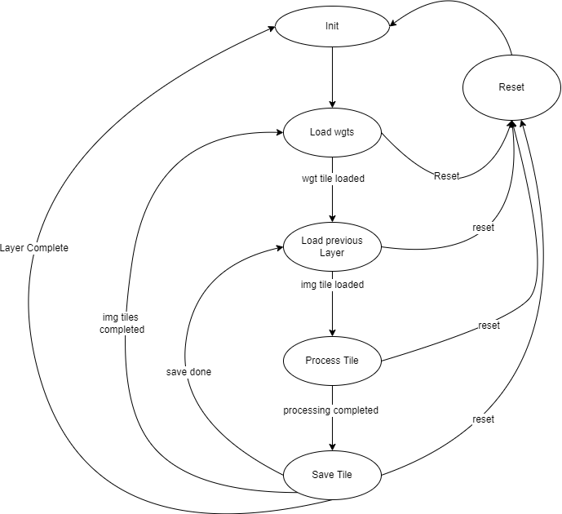
Extending the design to second layer: FSM
The job done in each state is as follows:
Init: Loads all layer related thresholds into desired regsiters
Load_wgt: The address generator loads weights in wgt_tile (all depths)
Load_img: Once a single weight is loaded, image tile is loaded. A portion based on input layer size. All depths are loaded at once
Process_tile: This stage utilizes on chip wgt_tile and Image_tile (all depths) along with compute engine to generate outputs and saves them on chip. The layer flag is used to see which CE output should be saved.
Save_tile: A complete output created on-chip is written to RAM using the schedule engine

Slide 19
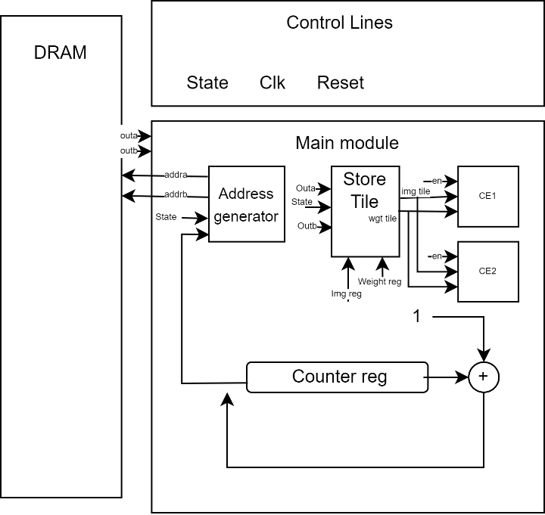
Extending the design to second layer: Micro-Architecture
Address Generator:
This module is used to communicate with DRAM while reading/writing any value. Based on the value of state, it uses different offsets and thresholds to create next address. There are counters that keep check of value (which value is to be stored), tile number (which tile of input image correspond to this), and weight number (which weight layer correspond to this). There is now an extra counter to load all the depths,.
Store Tile:
The outputs from DRAM is to be stored on-chip carefully. This module takes care of saving read value from DRAM at desired place of on-chip memory. This module also saves output generated from compute engine into on chip output tile before it is saved back to DRAM.

Slide 20
Extending the design to second layer: Micro-Architecture
Compute Engine (CE1):
This module takes 6*6 portion of Image_tile (present on chip), 5*5 weight matrix and applies convolutional as well as pooling formulas to compute corresponding single output, which is saved on-chip. The compute engine consists of:
100 multipliers for 4 dot products of (5*5) blocks of images with (5*5) weights
96 adders for completing that dot product
4 2-to-1 MUX to apply non-linearity (ReLu)
3 additional adders to complete average pooling (division here is done by shifting)

Slide 21
Extending the design to second layer: Micro-Architecture
Compute Engine (CE2):
This module takes 6*6*6 portion of Image_tile (present on chip), 5*5*6 weight matrix and applies convolutional as well as pooling formulas to compute corresponding single output, which is saved on-chip. The compute engine consists of:
600 multipliers for 4 dot products of (5*5*6) blocks of images with (5*5*6) weights
600 2-to-1 MUX for sign extension of each number to be added
596 adders for completing those 4 dot products
4 2-to-1 MUX to apply non-linearity (ReLU)
3 additional adders to complete average pooling (division here is done by shifting)

Slide 22
Results after second layer

Slide 23
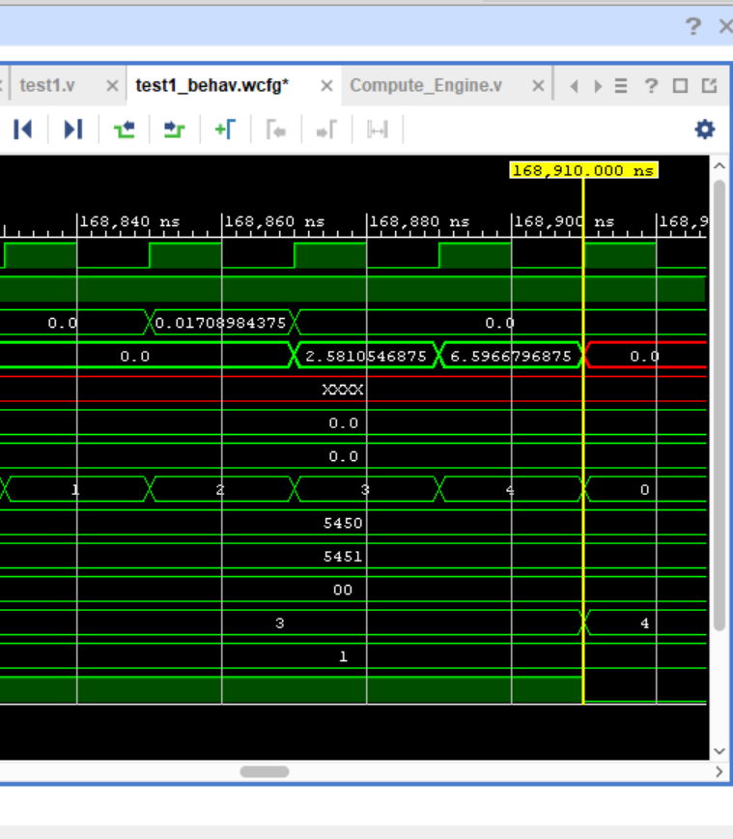
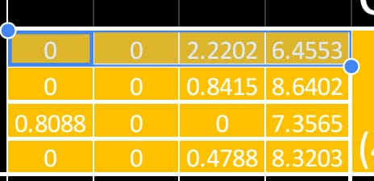
Results after first layer
Desired Output of first layer
Corresponding output on vivado

Slide 24
Adding Dense Layer: Final Design

Slide 25
Adding Dense Layer: Final Design
To add dense layer we did the following:
Made a dense engine that takes one row (1*192) of matrix and 1*192 vectorized input and computes the result
Although the layer has no depth, but to load 10 columns, we interpreted layer has depth 10 and hence loaded the results from corresponding position
Complete matrix 10*192 is loaded and one by each row is passed along with 1_192 of linearzed img array to dense engine and output is computed and saved

Slide 26
Adding Dense Layer: Final Design FSM
The job done in each state is as follows:
Init: Loads all layer related thresholds into desired regsiters
Load_wgt: The address generator loads weights in wgt_tile (all depths)
Load_img: Once a single weight is loaded, image tile is loaded. A portion based on input layer size. All depths are loaded at once
Process_tile: This stage utilizes on chip wgt_tile and Image_tile (all depths) along with compute engine to generate outputs and saves them on chip. The layer flag is used to see which CE output should be saved.
Save_tile: A complete output created on-chip is written to RAM using the schedule engine

Slide 27
Adding Dense Layer: Final Design Micro-Architecture
Address Generator:
This module is used to communicate with DRAM while reading/writing any value. Based on the value of state, it uses different offsets and thresholds to create next address. There are counters that keep check of value (which value is to be stored), tile number (which tile of input image correspond to this), and weight number (which weight layer correspond to this). There is now an extra counter to load all the depths,.
Store Tile:
The outputs from DRAM is to be stored on-chip carefully. This module takes care of saving read value from DRAM at desired place of on-chip memory. This module also saves output generated from compute engine into on chip output tile before it is saved back to DRAM.

Slide 28
Adding Dense Layer: Final Design Micro-Architecture
Compute Engine (CE1):
This module takes 6*6 portion of Image_tile (present on chip), 5*5 weight matrix and applies convolutional as well as pooling formulas to compute corresponding single output, which is saved on-chip. The compute engine consists of:
100 multipliers for 4 dot products of (5*5) blocks of images with (5*5) weights
96 adders for completing that dot product
4 2-to-1 MUX to apply non-linearity (ReLu)
3 additional adders to complete average pooling (division here is done by shifting)

Slide 29
Adding Dense Layer: Final Design Micro-Architecture
Compute Engine (CE2):
This module takes 6*6*6 portion of Image_tile (present on chip), 5*5*6 weight matrix and applies convolutional as well as pooling formulas to compute corresponding single output, which is saved on-chip. The compute engine consists of:
600 multipliers for 4 dot products of (5*5*6) blocks of images with (5*5*6) weights
600 2-to-1 MUX for sign extension of each number to be added
596 adders for completing those 4 dot products
4 2-to-1 MUX to apply non-linearity (ReLU)
3 additional adders to complete average pooling (division here is done by shifting)

Slide 30
Adding Dense Layer: Final Design Micro-Architecture
Compute Engine (DE):
This module takes one row 1*192 of WGT as well as vectorized 1*192 of input image and computes using simple dot product. The compute engine consists of:
192 multipliers for 1 dot product of (1*192) vector of images with (1*192) weights
192 2-to-1 MUX for sign extension of each number to be added
191 adders for completing that dot product

Slide 31
Problems

Slide 32
Problems
After running the design we have few problems that we cant solve:
The output of second layer matches well but a few values 5-10 are quite different from expected output
The dense engine is not giving output (gives high impedance xxxx). This could be because addressing for dense engine is not working properly and we did not had time to remove this issue

